Slide 1
Immanuel Lutheran Church
Pastoral Listing
1896 - 2026

Slide 2
Thank God for the
faithful pastors,
who have led us
in worship, keeping the
Holy Scriptures
as their guide and rule.

Slide 3
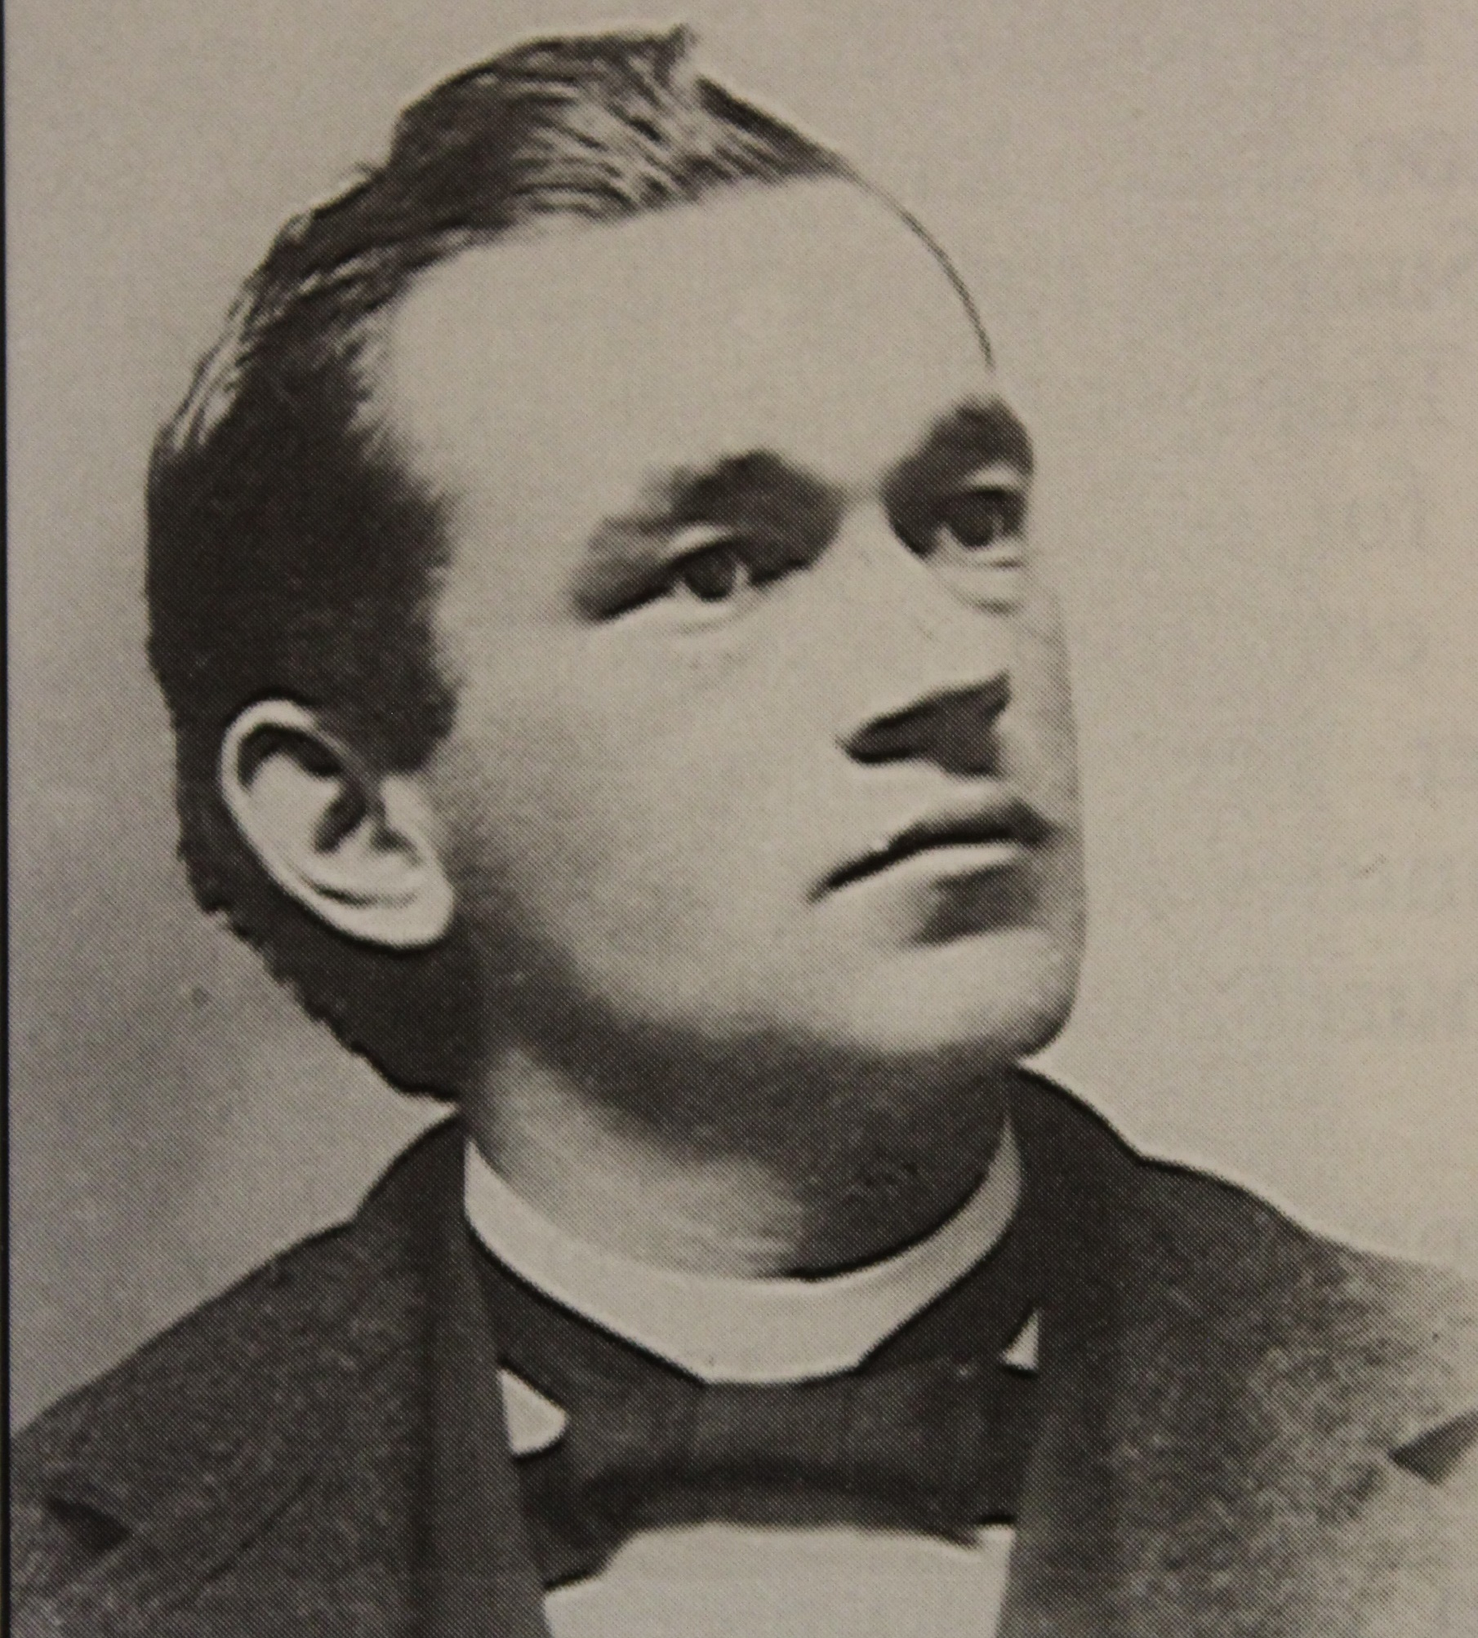
Reverend
William
Tabbert
1896 - 1928

Slide 4
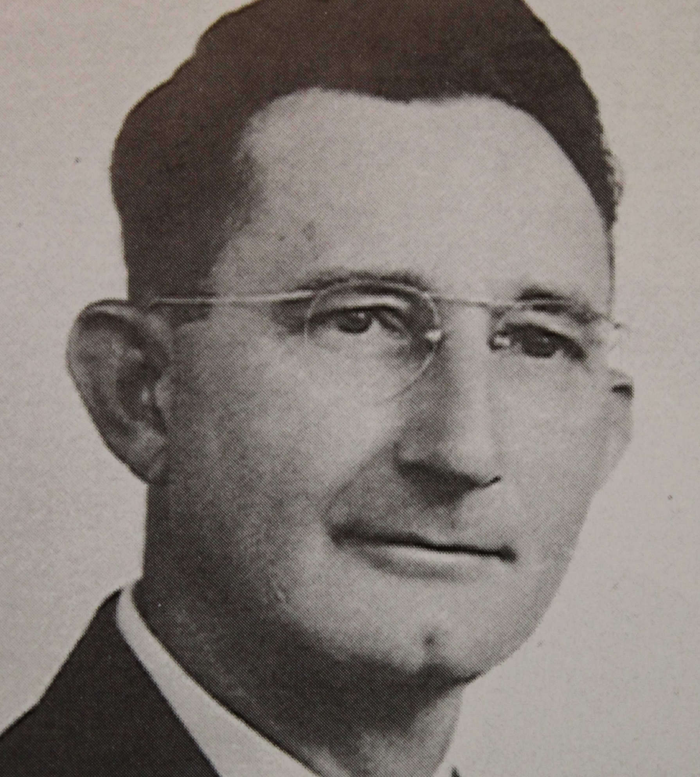
Reverend
O.H. Knoll
1928 - 1942

Slide 5
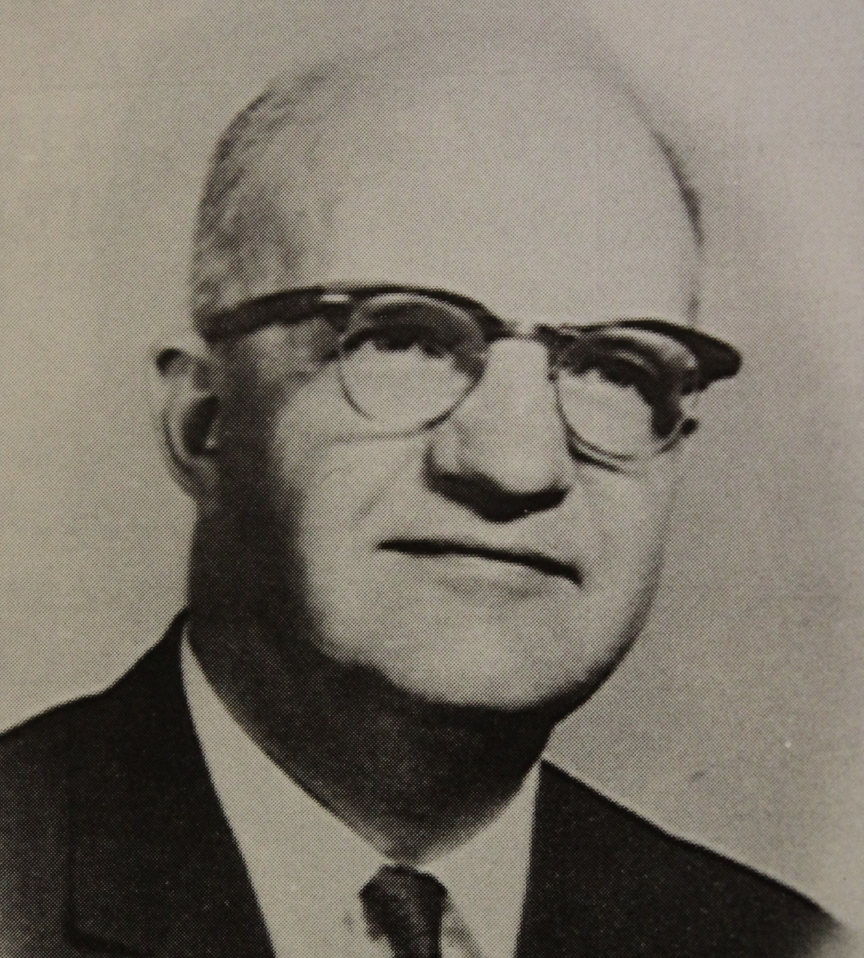
Reverend
H.A. Ott
1942 - 1954

Slide 6
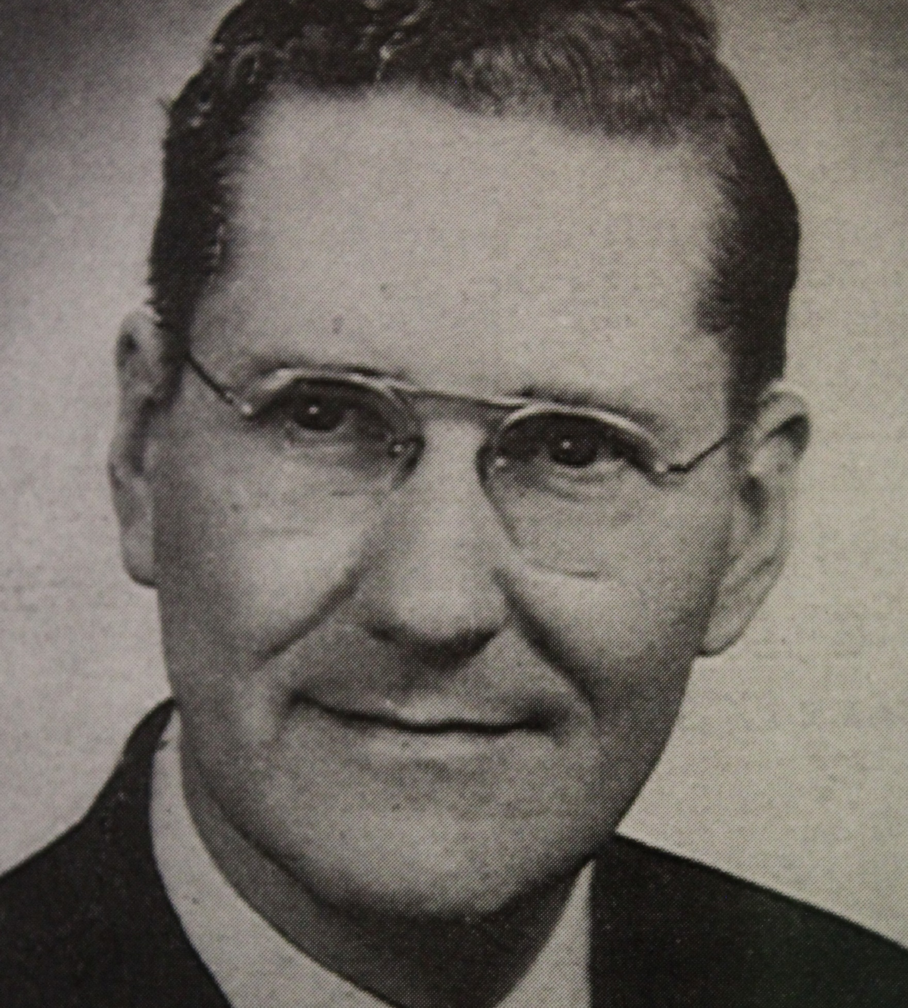
Reverend
Theodore
Stolp
1954 - 1960

Slide 7
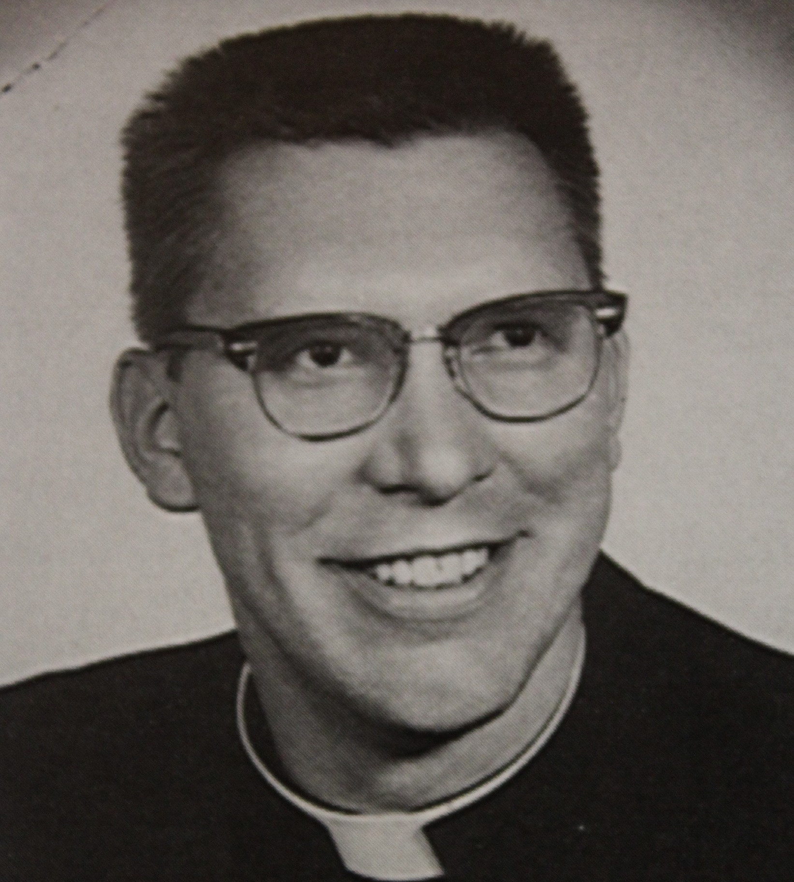
Reverend
David
Wacker
1960- 1971

Slide 8
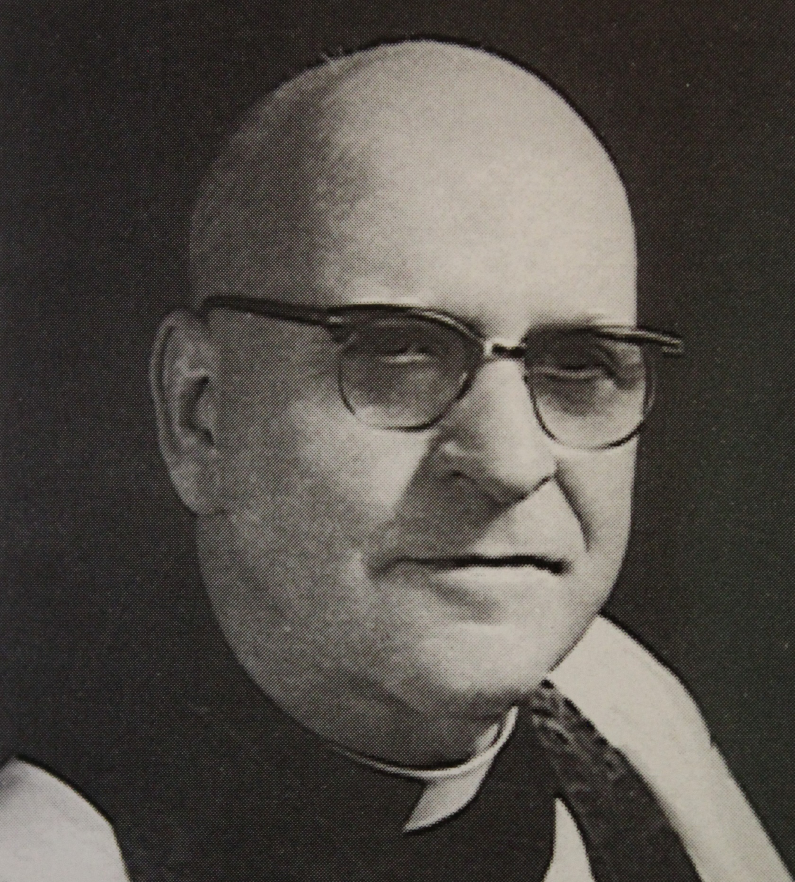
Reverend
Herbert
Wacker
1969 - 1971

Slide 9
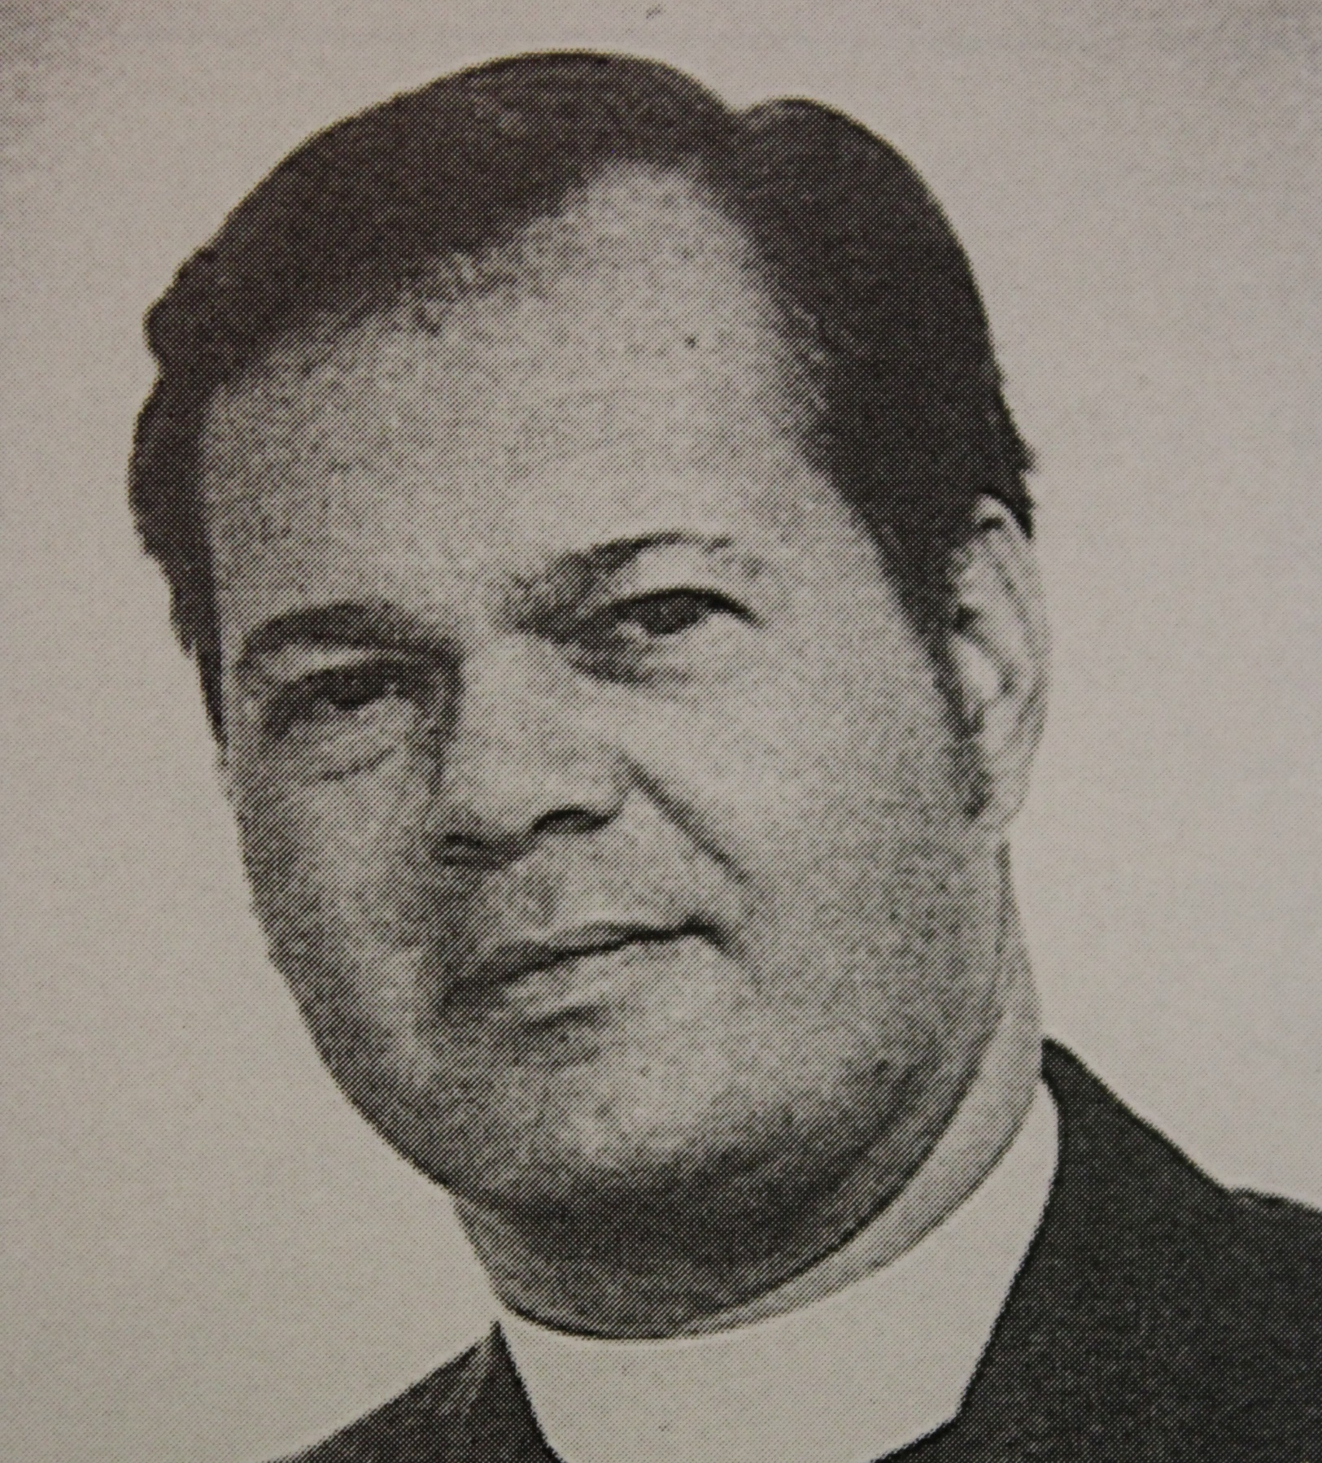
Reverend
Kenneth
Piepenbrink
1971 - 1974

Slide 10
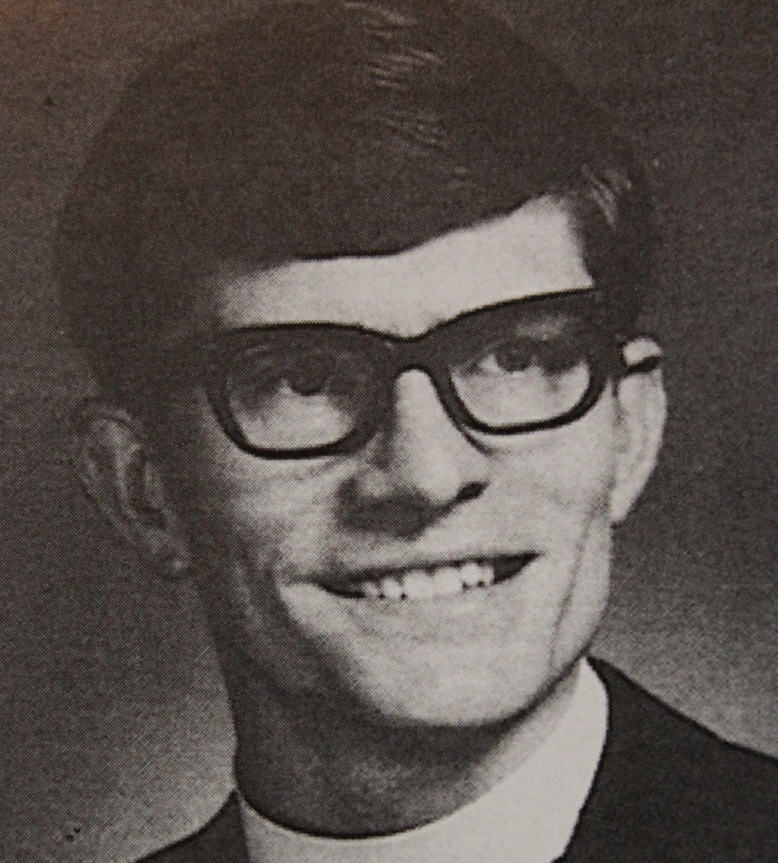
Reverend
Rodney D.
Otto
1973 - 1981

Slide 11
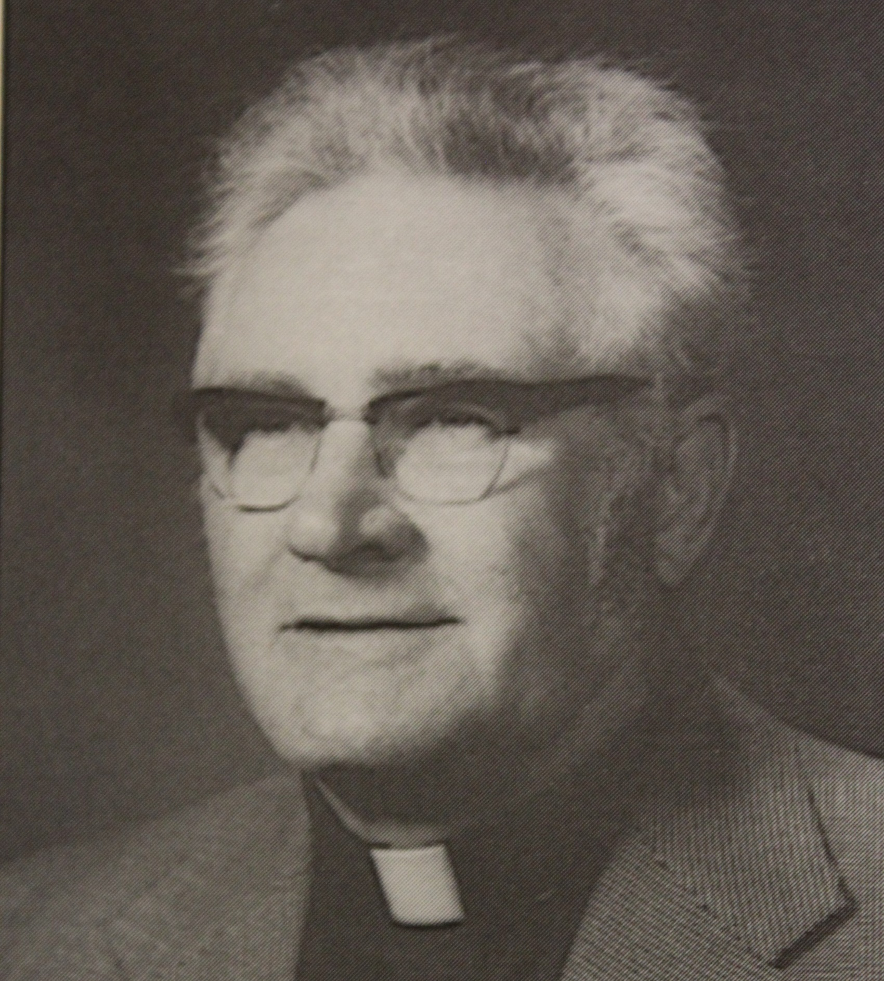
Reverend
Wilfred J.
Rittamel
1975 - 1982

Slide 12
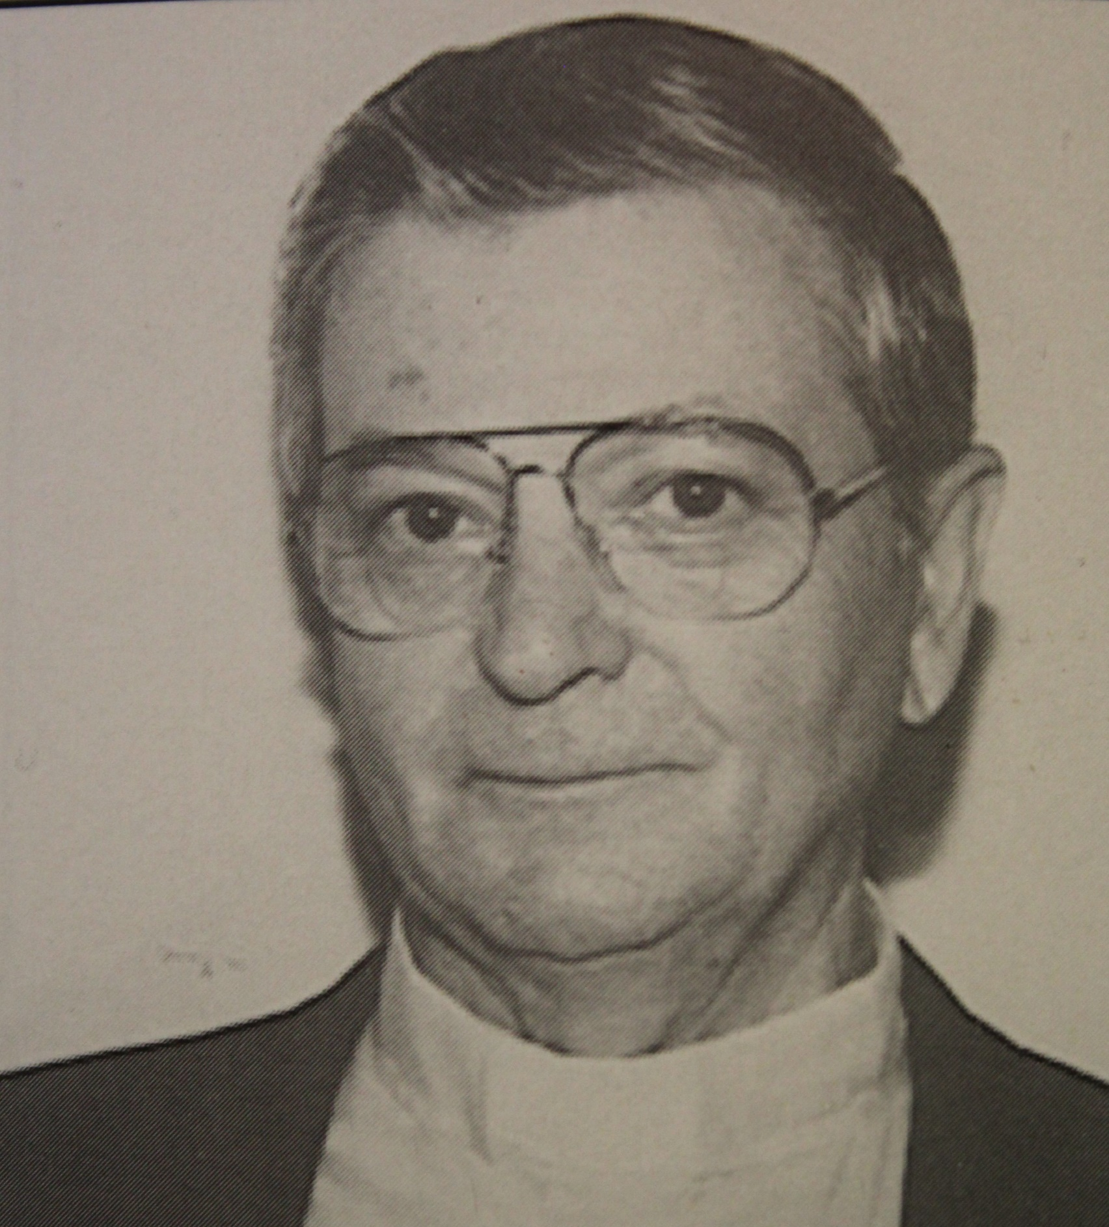
Reverend
Phillip
Florip
1982 - 1989

Slide 13
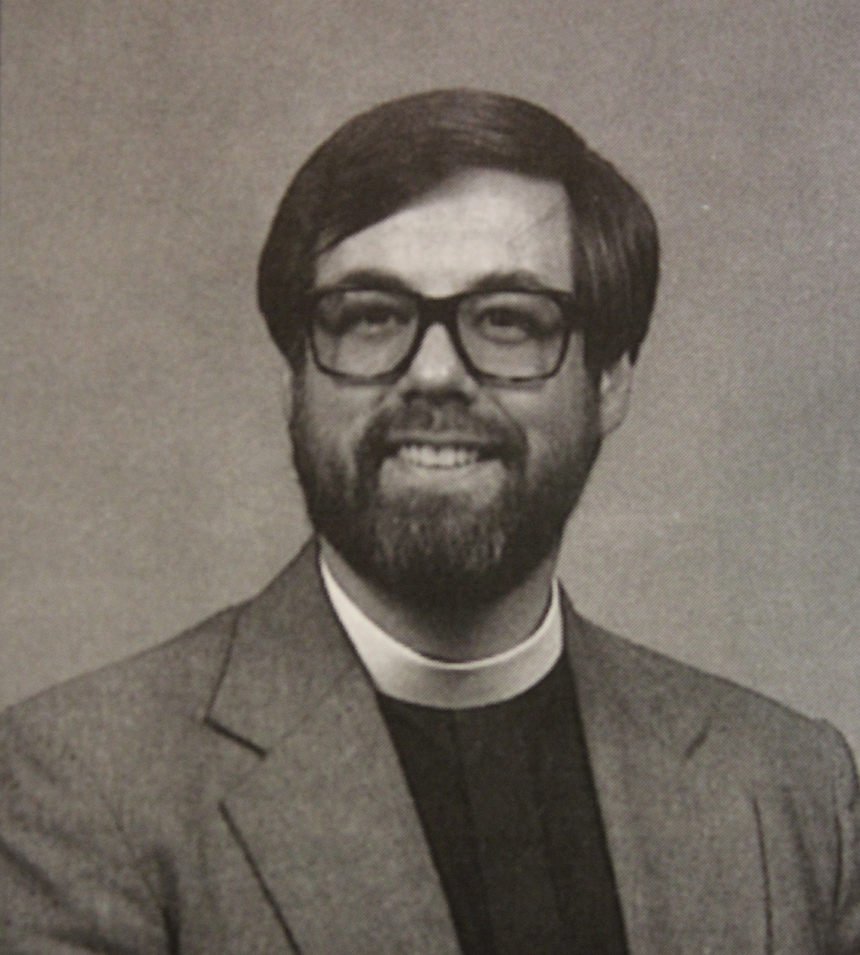
Reverend
James A.
Schouweiler
1988 - 2003

Slide 14
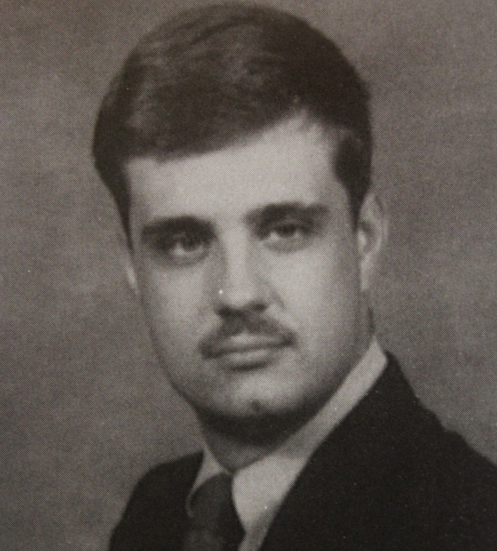
Reverend
Paul Lauer
1991 - 1994

Slide 15
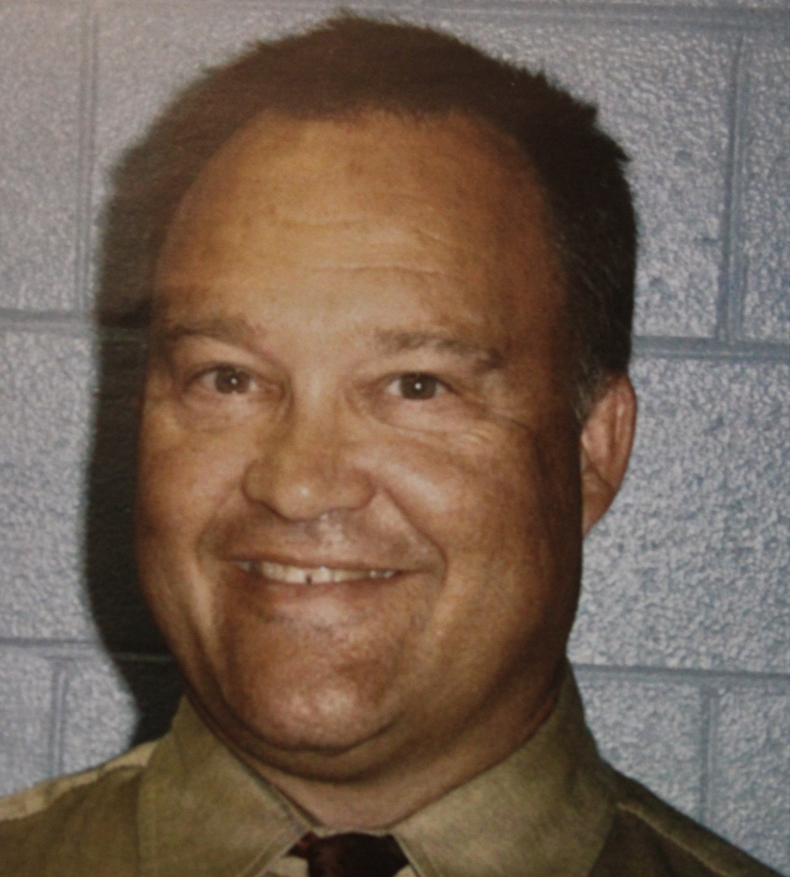
Reverend
Jon
Bendewald
2005 - 2014

Slide 16
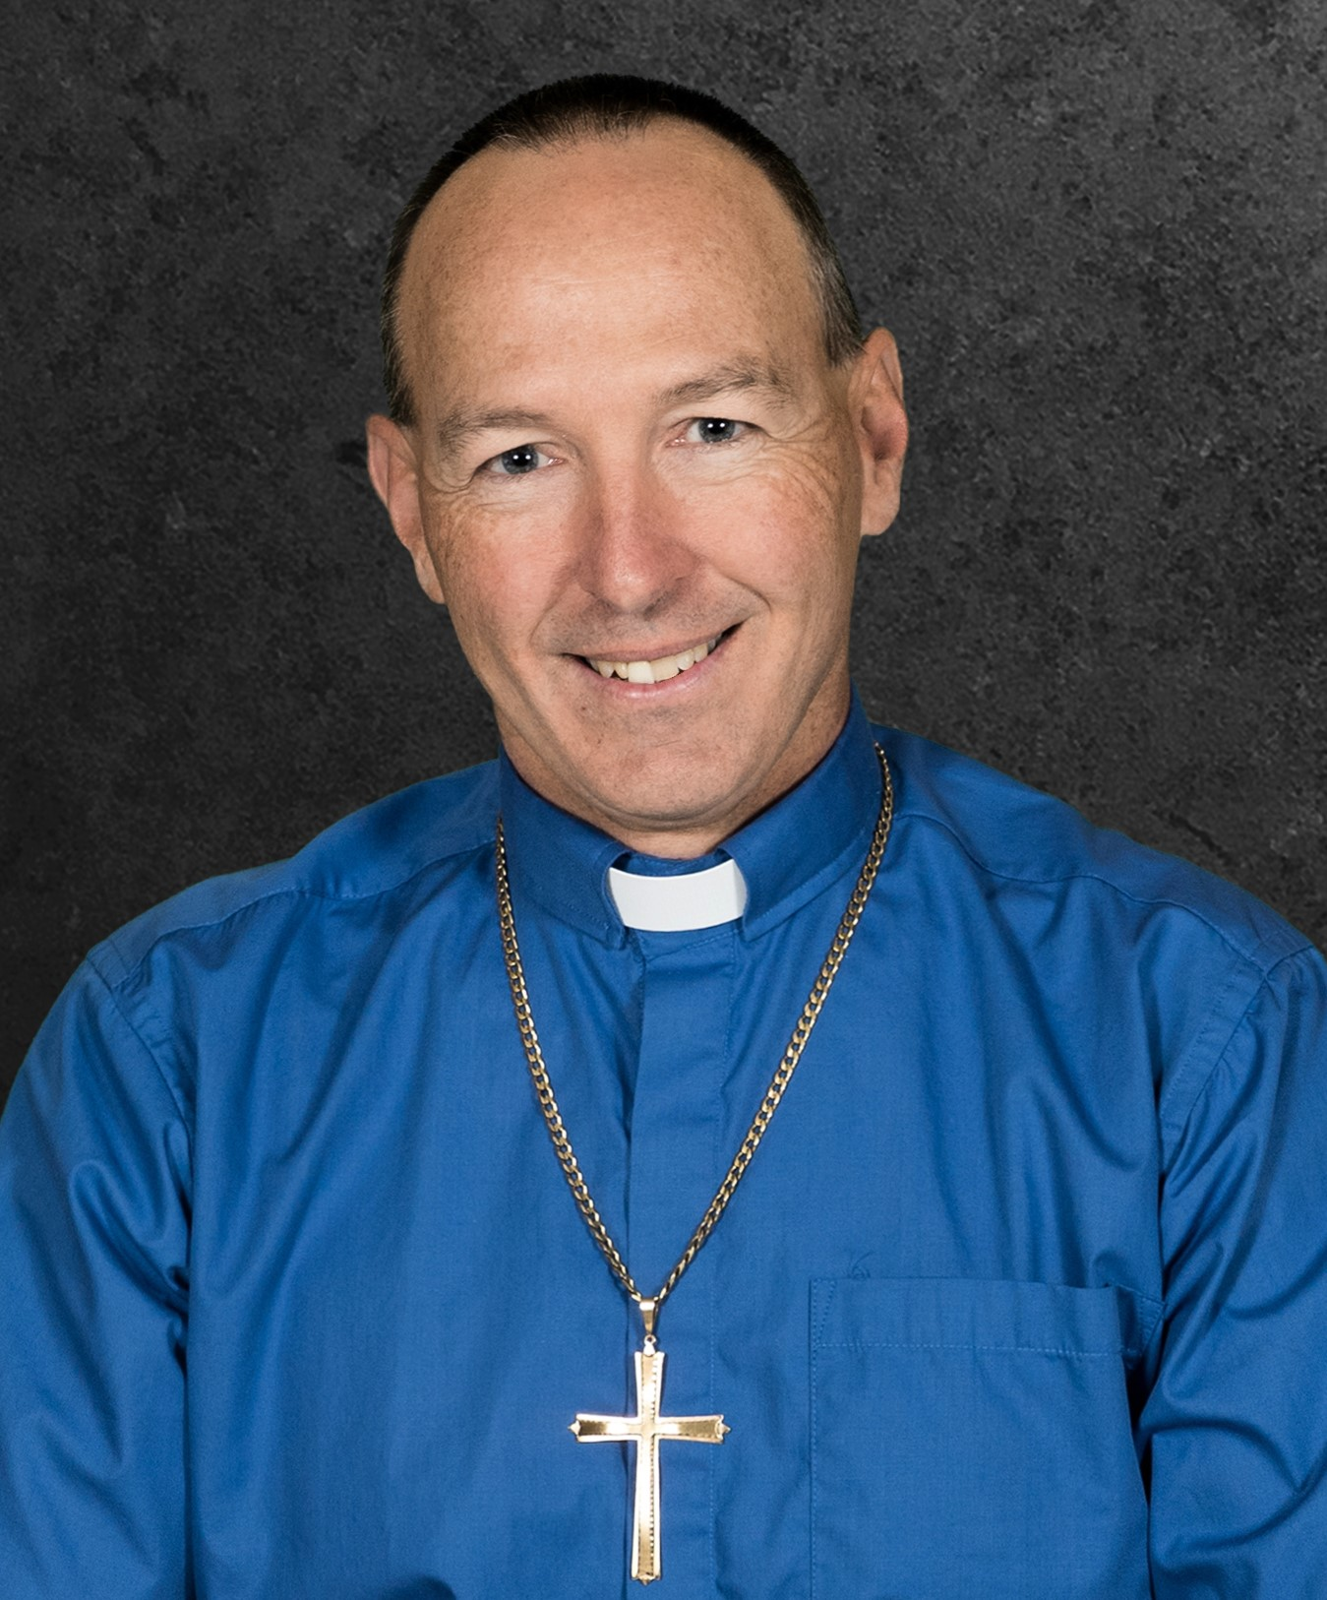
Reverend
Ed
Meyer
2018 - 2021

Slide 17
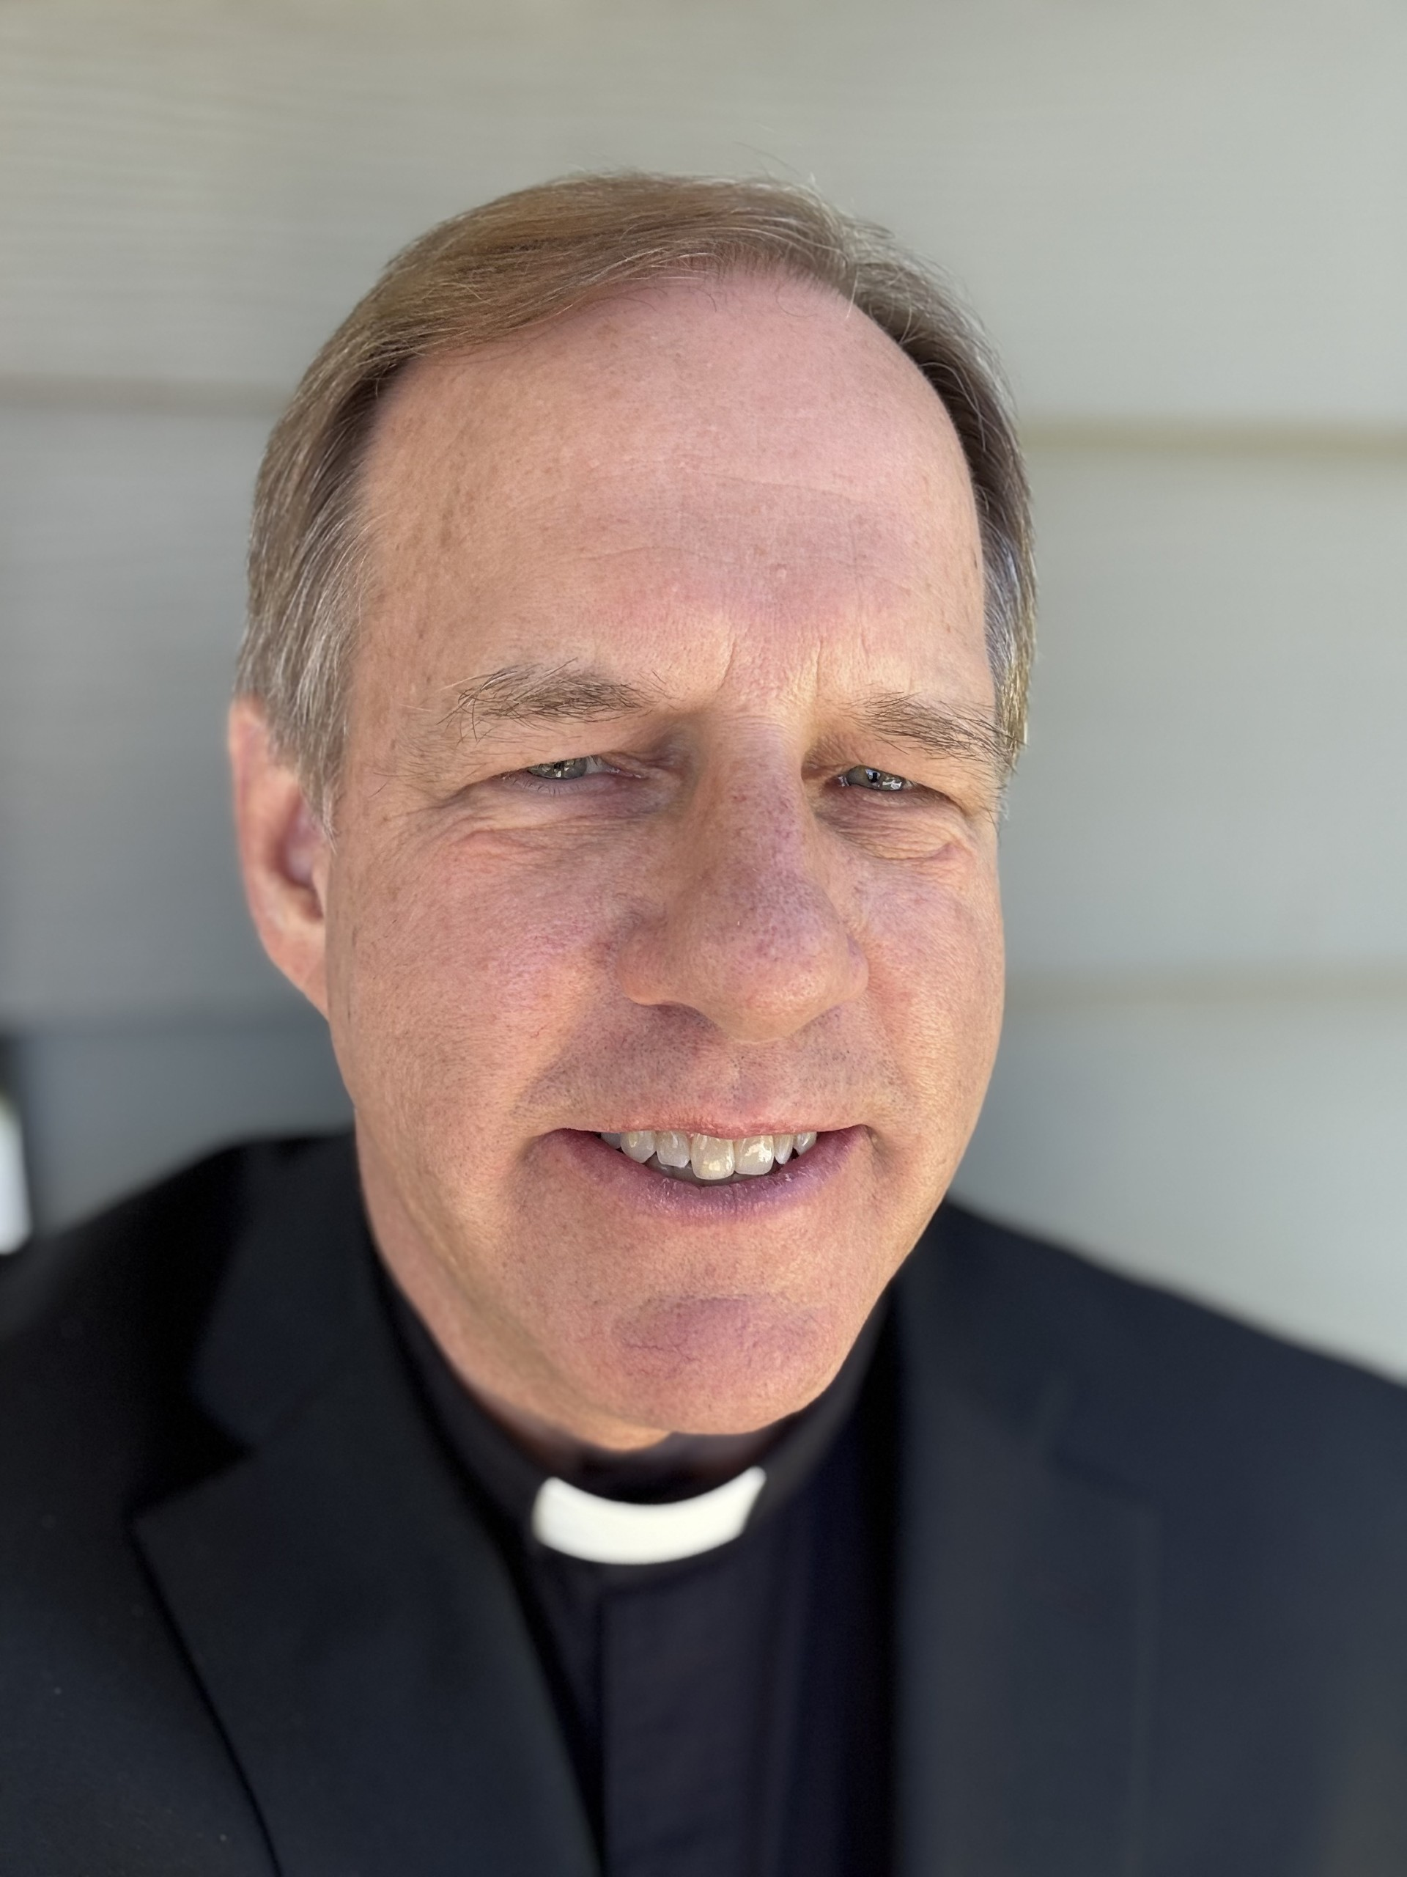
Reverend
Dr. Douglas
Krengel
2023 -

Slide 18
Reverend
Paul Dobberstein
2005 -

Slide 19
Reverend
Thomas Brazinsky
2017 - 2018

Slide 20
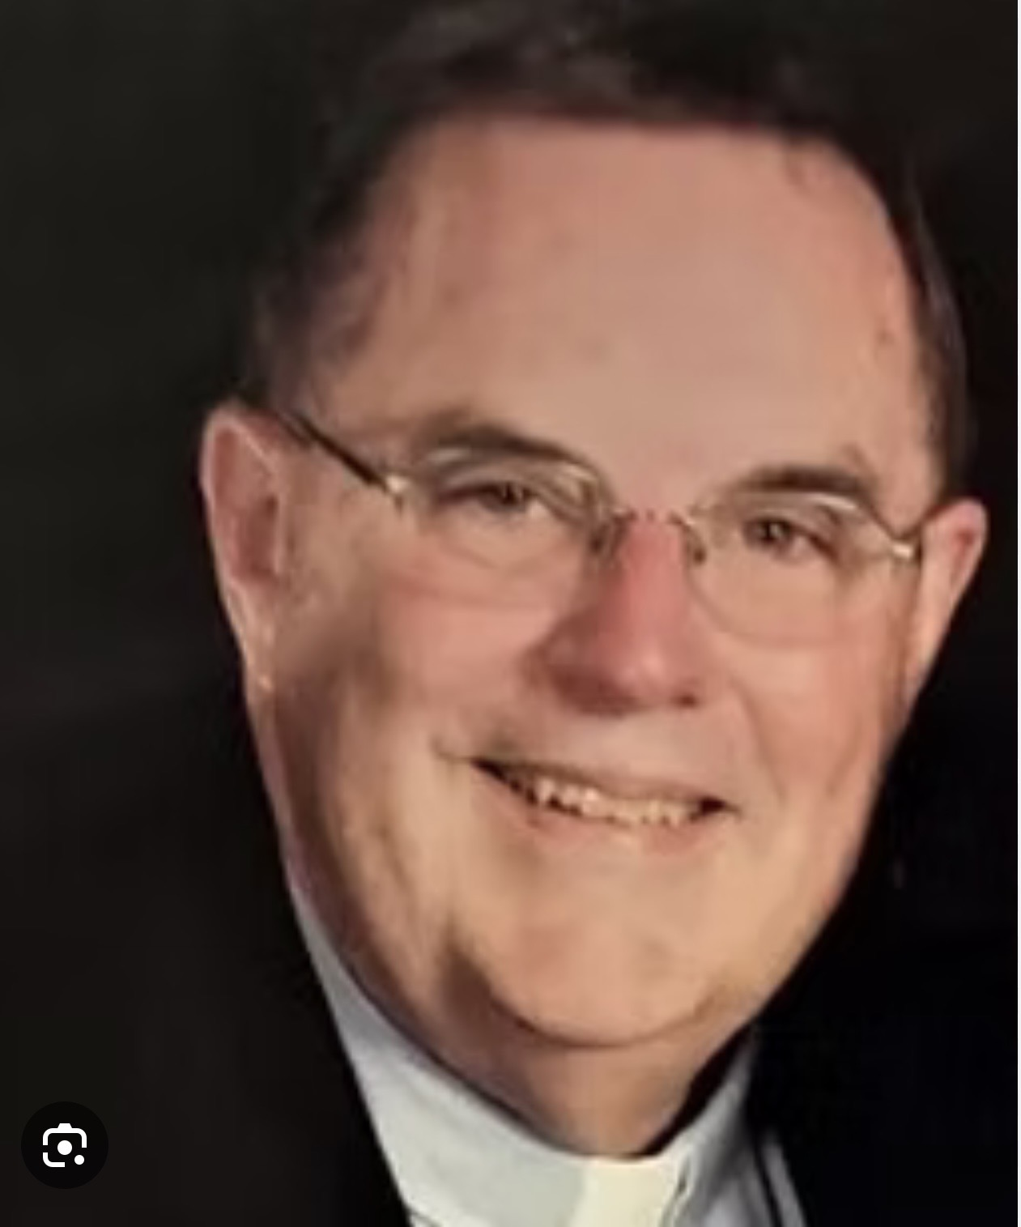
Reverand
Carl
Bassett
2021 - 2023
2014 - 2018

Slide 21
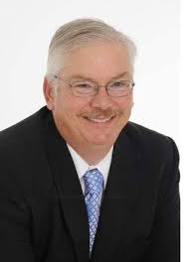
Reverand
Thomas
Fischer
2020 - 2022

Slide 22
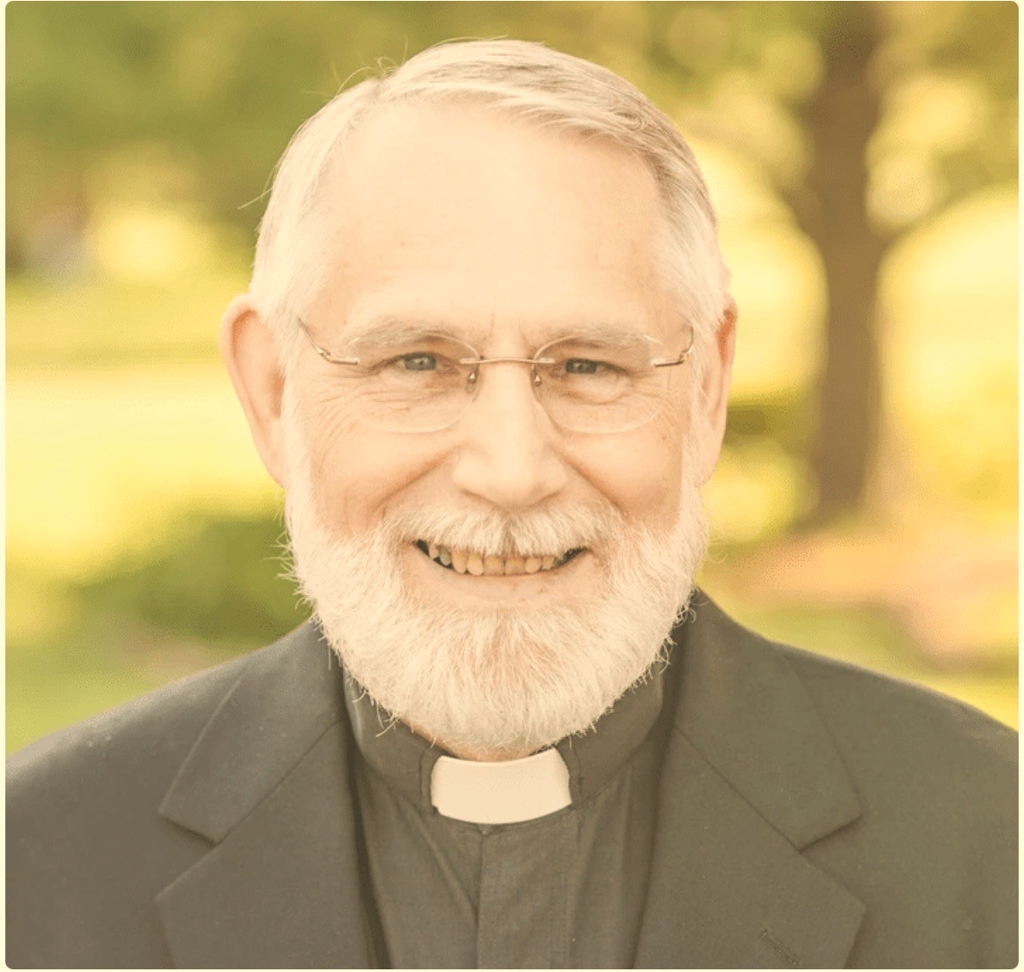
Reverand
William
Gleason
2003 - 2005

